Slide 1

About team | Problem Statement | Project Overview | Dataset | Architecture | ML Model | Output | Conclusion
JOBfit.
SUMMER TRAINING PROJECT

Slide 2


About team | Problem Statement | Project Overview | Dataset | Architecture | ML Model | Output | Conclusion
About Team
GROUP 08
SOUMYA SONEJA 2401020061
DHRUVI SHARMA 992401030276
ANSHIKA SRIVASTAV 2405170095
AARUSH BAHUGUNA 2401200026

Slide 3
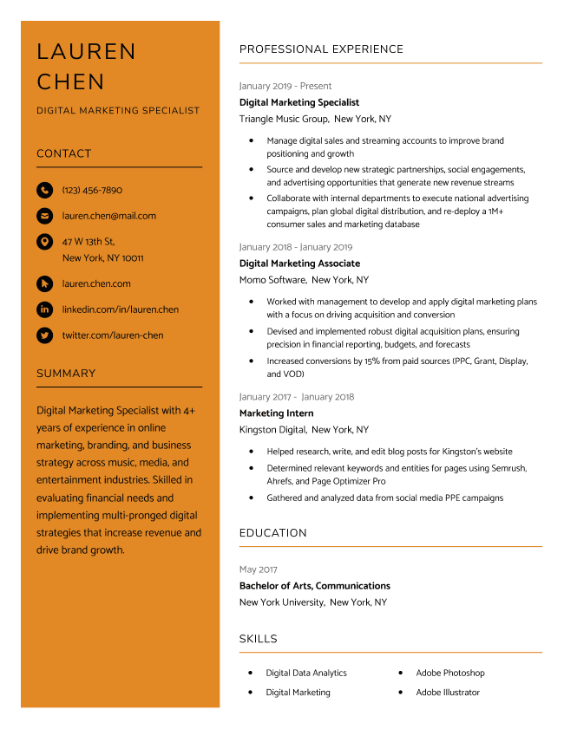
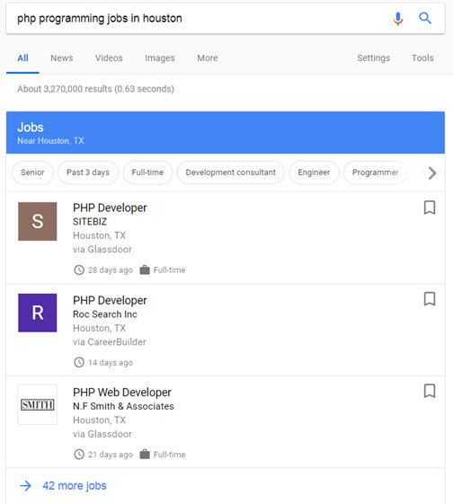


About team | Problem Statement | Project Overview | Dataset | Architecture | ML Model | Output | Conclusion
Problem Statement
Despite the growing availability of online learning resources and career guidance tools, professionals and students often struggle to identify the exact skills they lack for transitioning into their desired job roles. Traditional methods rely heavily on self-assessment or generic advice, which may not accurately reflect the real-world expectations of a job market. There is a critical need for a data-driven system that can analyze individual resumes, compare them with industry-aligned profiles, and automatically detect missing skills—enabling users to take focused, actionable steps in their career development.

Slide 4

About team | Problem Statement | Project Overview | Dataset | Architecture | ML Model | Output | Conclusion
Overview
OBJECTIVE :
To assist professionals in identifying and bridging skill gaps for successful career transitions by analyzing their current resumes and desired job roles using Machine Learning (ML) and Information Retrieval (IR) techniques.
SOLUTION : The system enables users to upload their resume and specify a target job role. It then:
Parses the resume and extracts current skills.
Analyzes the skill requirements of the desired role.
Identifies the skill gap.
Recommends personalized learning resources (MOOCs, tutorials, certifications) to fill the gap.
Technical Stack :
Resume Parsing & Skill Extraction (using NLP techniques)
Job Role Embedding & Similarity Comparison
Skill Gap Detection via semantic vector comparison
Key Features :
Upload and analyze resumes in real-time.
Match skills to job roles using embeddings.
Personalized resource recommendation engine.
User-friendly web interface (Flask/Django-based frontend).

Slide 5
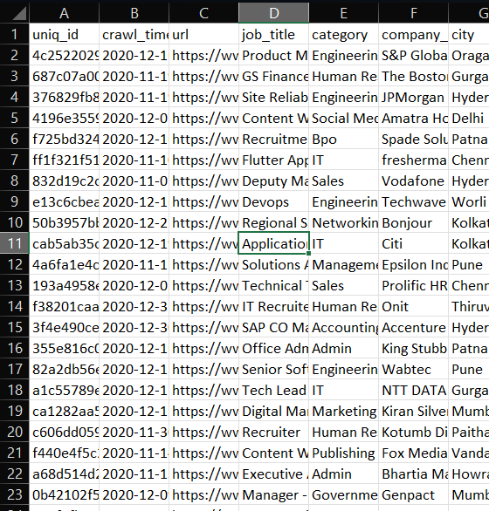
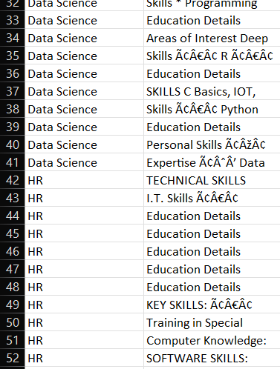


About team | Problem Statement | Project Overview | Dataset | Architecture | ML Model | Output | Conclusion
DATASETs USED
Job Dataset: job_postings.csv
Contains job listings with descriptions and job titles
Column used: job_description
Cleaned similarly to resume text
Used for:
Extracting required job skills
Matching resumes via cosine similarity
Resume Dataset: UpdatedResumeDataSet.csv
Contains real-world resumes with categories (e.g., Data Science, HR, etc.)
Column used: Resume
Cleaned using regular expressions and punctuation removal
Used for:
Analyzing candidate skill sets
Training match classification model
Dataset Stats.
1000+ resumes
2000+ job descriptions
Coverage: Technical and non-technical roles

Slide 6
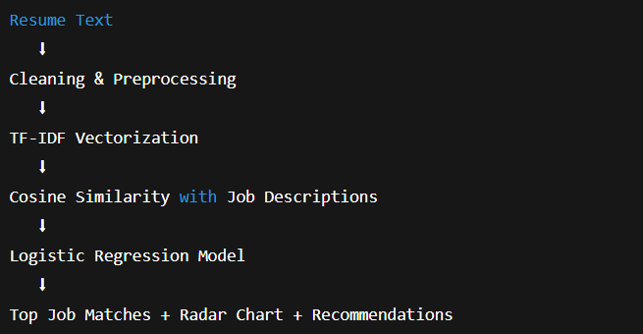
About team | Problem Statement | Project Overview | Dataset | Architecture | ML Model | Output | Conclusion
Step-by-Step Architecture Overview
User Input:
Paste resume as plain text on the web interface.
Text Preprocessing:
Removes HTML tags, punctuation
Converts to lowercase using the clean_text() function
TF-IDF Vectorization:
Converts text into numerical vectors
Captures importance of words across resumes and job descriptions
Cosine Similarity:
Compares resume with all job descriptions
Finds top 3 closest job matches based on similarity scores
Logistic Regression Model:
Predicts match relevance using similarity score
Trained to label resumes as good match (1) or weak match (0)
Radar Chart Generation:
Predefined skill set used to compare resume vs. job
Skills like Python, Flask, SQL, ML, etc.
Recommendations Engine:
Identifies missing skills
Suggests learning resources (courses & GitHub projects)

Slide 7
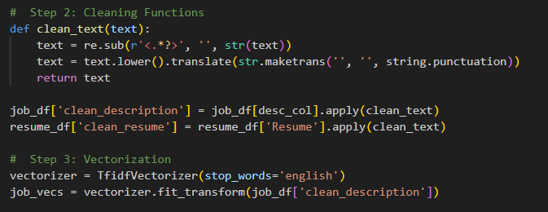
About team | Problem Statement | Project Overview | Dataset | Architecture | ML Model | Output | Conclusion
Text Cleaning +
TF-IDF
Text Preprocessing
Raw resume and job description text often contains:
HTML tags, symbols, punctuation, inconsistent casing
We use a clean_text() function to:
Remove HTML (<.*?>)
Lowercase the text
Remove punctuation
Ensures the text is in a consistent format for ML processing
TF-IDF Vectorization
TF-IDF = Term Frequency – Inverse Document Frequency
Converts cleaned text into numerical vectors
Measures how important a word is in a document relative to a collection of documents
Captures the uniqueness of skills/terms in resumes and job descriptions
Helps identify key similarities and differences

Slide 8
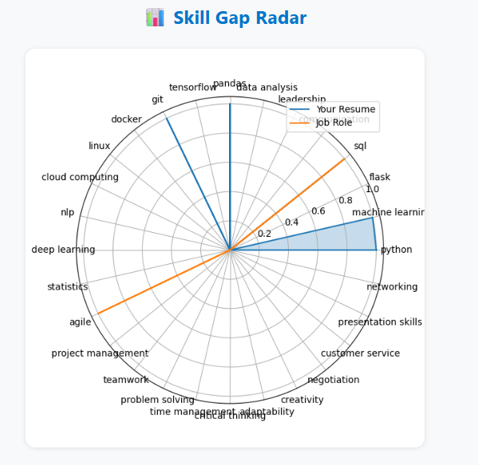
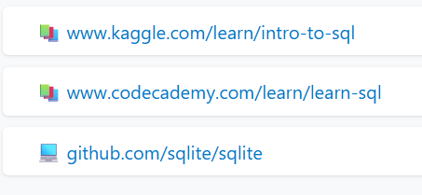
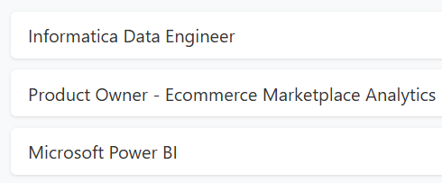

About team | Problem Statement | Project Overview | Dataset | Architecture | ML Model | Output | Conclusion
Logistic Regression Model
After computing cosine similarity between resume and job descriptions:
A Logistic Regression model predicts if the resume is a strong match
Input Feature: Top similarity score
Target Label:
1 if similarity > 0.3 → good match
0 otherwise
Helps filter low-quality matches and prioritize relevant job roles
Radar Chart: Skill Comparison
Compares presence of predefined skills in:
Resume
Job description
Skills considered: Python, Machine Learning, SQL, Flask, Communication, Leadership
Visual feedback on where the user is lacking
Personalized Recommendations
For every missing skill (present in job but not in resume):
Suggests top courses (Coursera, Udemy, etc.)
Suggests open-source projects (GitHub)
Helps user take action and improve resume alignment

Slide 9
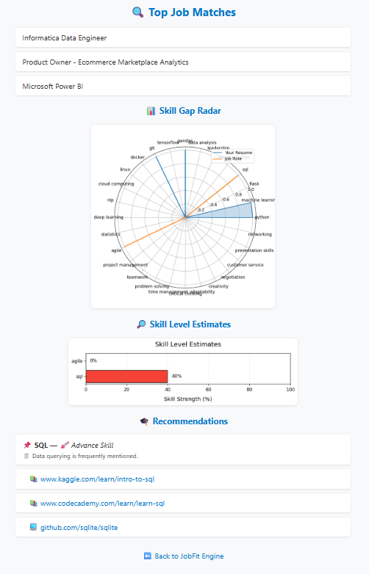
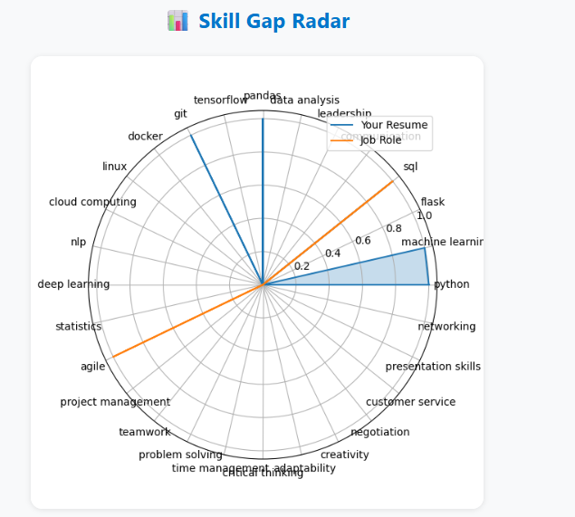
OUTPUT
About team | Problem Statement | Project Overview | Dataset | Architecture | ML Model | Output | Conclusion
What the Application Delivers
Accepts resume text via a web interface
Matches the resume to top 3 most similar job roles
Highlights missing skills through a radar chart
Suggests courses and GitHub projects to bridge skill gaps

Slide 10
About team | Problem Statement | Project Overview | Dataset | Architecture | ML Model | Output | Conclusion
What We Achieved
Built a complete ML pipeline:
Cleaned and vectorized resume/job text
Calculated job match score using cosine similarity
Trained a simple ML model for match classification
Created a radar chart to visualize skill gaps
Offered learning resources to help candidates upskill
CONCLUSION
Challenges Faced
Handling messy or unstructured resume data
Hardcoding skills instead of extracting them automatically
Matching soft skills (e.g., communication, leadership) with accuracy
Future Scope
🔬 Use NLP techniques to auto-extract skills from any text (not just keywords)
🧠 Incorporate soft skill detection using sentiment and context analysis
🔗 Connect with real job APIs (like LinkedIn, Indeed) for live job data
📄 Parse uploaded PDF resumes automatically
📊 Improve visualization using dynamic radar charts or interactive dashboards

Slide 11
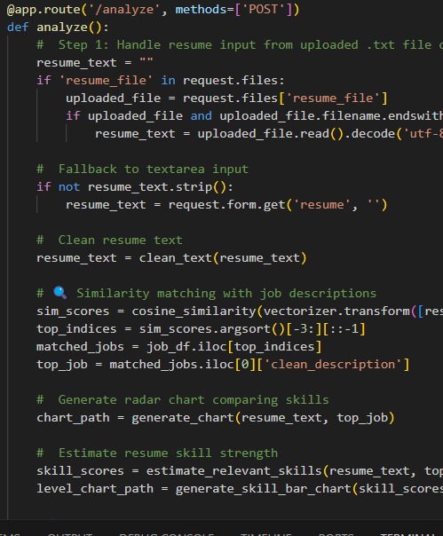
Thank You

